Slide 1
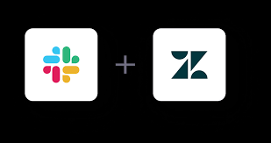
USE CASE:
Slack - Zendesk Integration using ClearFeed

Slide 2
The use case here is integrating Slack with Zendesk using ClearFeed to improve customer support.
What Problem Does This Solve?
Many businesses use Slack for team communication and Zendesk for customer support tickets. However, customers often raise issues in Slack channels, and agents need to manually copy them to Zendesk as tickets.
This manual process is: ❌ Time-consuming ❌ Error-prone ❌ Lacks real-time tracking
How Does ClearFeed Help?
ClearFeed acts as a bridge between Slack and Zendesk. It allows support teams to: ✅ Automatically create Zendesk tickets from Slack messages ✅ Sync responses between Slack and Zendesk in real time ✅ Track ticket updates inside Slack ✅ Manage customer queries efficiently without switching platforms

Slide 3
Introduction – Why This Integration?
Problem Statement:
❌ Customers raise issues in Slack, but support teams use Zendesk. ❌ Manual ticket creation is slow & inefficient. ❌ No easy way to track updates in Slack.
Solution with ClearFeed:
✅ Automates ticket creation from Slack to Zendesk. ✅ Enables two-way syncing for real-time updates. ✅ Reduces response time & improves customer experience.
Purpose of the Integration: ✅ Create & Manage Tickets from Slack (Manual & Automatic) ✅ Bidirectional Sync (Messages, Comments, Status Updates) ✅ Custom Forms & Collections for efficient request handling ✅ Slack Triage Channel for internal collaboration ✅ Real-time Notifications & Status Updates

Slide 4
Overview of ClearFeed Integration
ClearFeed: A platform that connects Slack with external ticketing systems like Zendesk for seamless support management.
What Does ClearFeed Do?
Connects Slack with Zendesk.
Converts Slack messages into Zendesk tickets.
Keeps both platforms in sync.
🎯 Goal: Seamless support workflow without leaving Slack.
Benefits: Faster support, seamless tracking, automated workflows
Steps to Integration: 1. Connect Slack to ClearFeed 2. Connect Zendesk to ClearFeed 3. Configure Ticketing automation (Manual or Auto Mode)
4. Sync requests, replies, and status updates

Slide 5
Connecting Slack to ClearFeed
Steps:
1. Log into ClearFeed & go to Integrations. 2. Click Authorize Slack & authorize access. 3. Select Slack channels for ticketing. 4. Configure settings for ticket creation & tracking.
Connecting Zendesk to ClearFeed
Steps:
1. Go to Integrations in ClearFeed. 2. Click Connect Zendesk & log in. 3. Choose how tickets should be created (manual/auto). 4. Set up ticket mapping & syncing rules.
Note: Before Performing Integration with Zendesk, Make Sure to have an account registered with Zendesk (Under 14 Days Free Trial Plan)

Slide 6
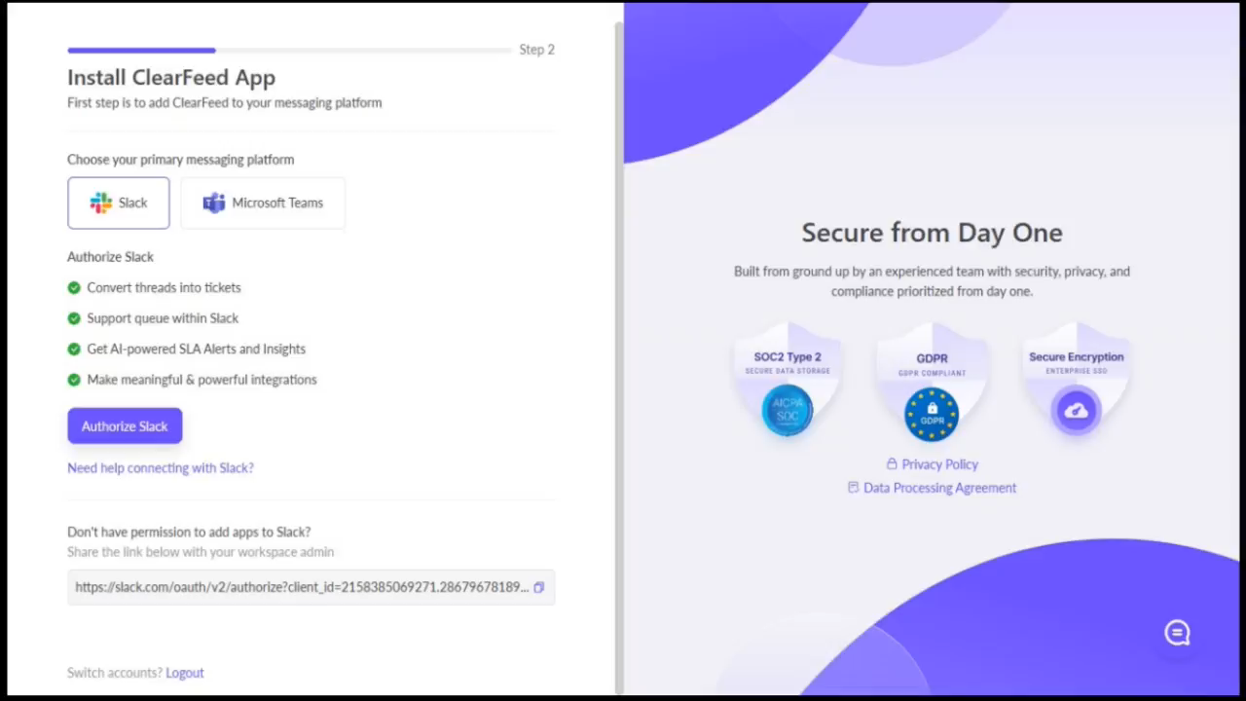
VIDEO DEMONSTRATION-1:

Slide 7
Configuring ClearFeed for Ticket Creation
Steps:
- Define rules for ticket creation in Slack.
- Choose Slack commands for manual ticket creation.
- Enable automatic ticket syncing & status updates.
- Test the integration with a sample ticket.
Process:
After successfully integrating your Zendesk account with ClearFeed, Enable Ticketing in ClearFeed using mode as Emoji (Manual) or Automatic.
Creating Zendesk Tickets either Automatically or Manually (Using Emoji) from Slack or from Triage Channel.
ClearFeed enables bidirectional sync of messages, status updates, comments, and labels between Slack and Zendesk, ensuring seamless ticket tracking and resolution.
While the Slack thread displays the Ticket’s Title, ID, URL, and Status for easy tracking.
ClearFeed creates a request for any new message in request channels, allowing teams to handle them within Slack or convert long-standing requests into Zendesk tickets.
Users can manually apply Emoji on a Slack thread to create a ticket, while automatic triggers generate tickets from messages by non-responders.
Once a ticket is created, ClearFeed updates the Slack thread with the Ticket ID, Title (link), and Color-Coded Status for easy tracking.

Slide 8
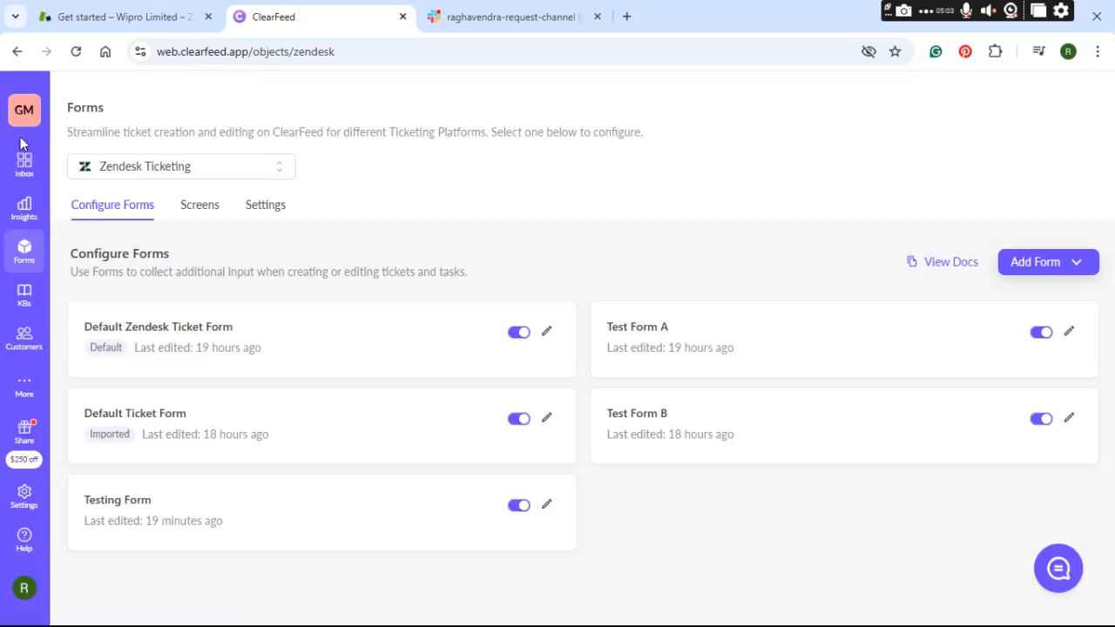
VIDEO DEMONSTRATION-2:

Slide 9
Forms in ClearFeed:
Customizable ticket forms allow users to input structured data when creating Zendesk tickets from Slack.
Helps capture specific details like priority, category, and issue description.
Ensures consistent ticket creation and reduces back-and-forth communication.
Collections in ClearFeed:
Groups related Slack conversations into a single collection for better organization.
Helps teams manage similar or recurring issues efficiently.
Allows for bulk actions like assigning, closing, or tagging multiple requests.
Key Features & Benefits
Who Benefits?
✅ Instant Ticket Creation – No manual data entry. ✅ Two-Way Sync – Updates in Zendesk reflect in Slack. ✅ Auto-Tagging & Categorization – Better organization. ✅ Real-Time Notifications – No missed updates.
- Support Teams → Can manage tickets without leaving Slack
- Customers → Get faster responses
Businesses → Improve support efficiency
This integration is useful for companies that: ✔ Have dedicated Slack channels for customers ✔ Want to streamline ticket creation & tracking ✔ Use Zendesk as their primary support tool

Slide 10
Common Issues & Troubleshooting
🚨 Issue: Slack messages not creating tickets ✅ Fix: Check Slack channel permissions.
🚨 Issue: Zendesk not receiving tickets ✅ Fix: Ensure API access is enabled.
🚨 Issue: Tickets not updating in Slack ✅ Fix: Verify webhook settings in ClearFeed.

